Slide 1

FM Synthesis
HW3 Presentation – 31/05/21

Slide 2

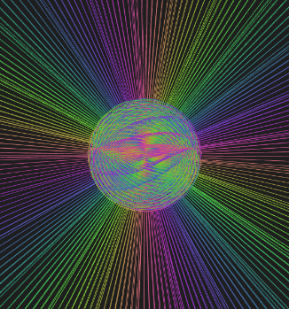
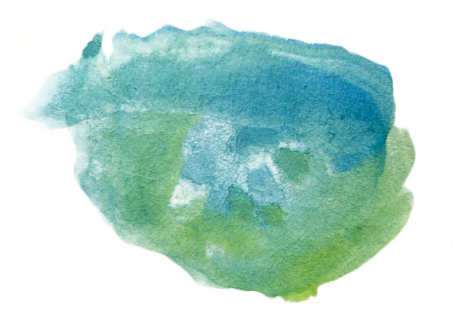
Hello!
We are group 2
And we are going to present our personal FM Synthesizer
You can find our code @ https://github.com/EllDy96/CarlGang/tree/Homework3

Slide 3
Introduction
SuperCollider implementation
Interaction design
Demo
Improvements roadmap
Index

Slide 4
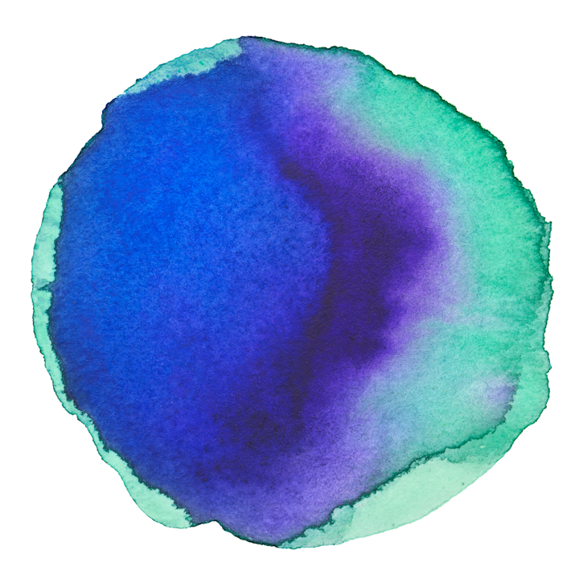
Assignment
Implement an instrument based on FM synthesis and an interface for controlling it.
1 Introduction
Implementation
Synthesis part: SuperCollider
Interaction part: ml5.js and p5.js frameworks

Slide 5
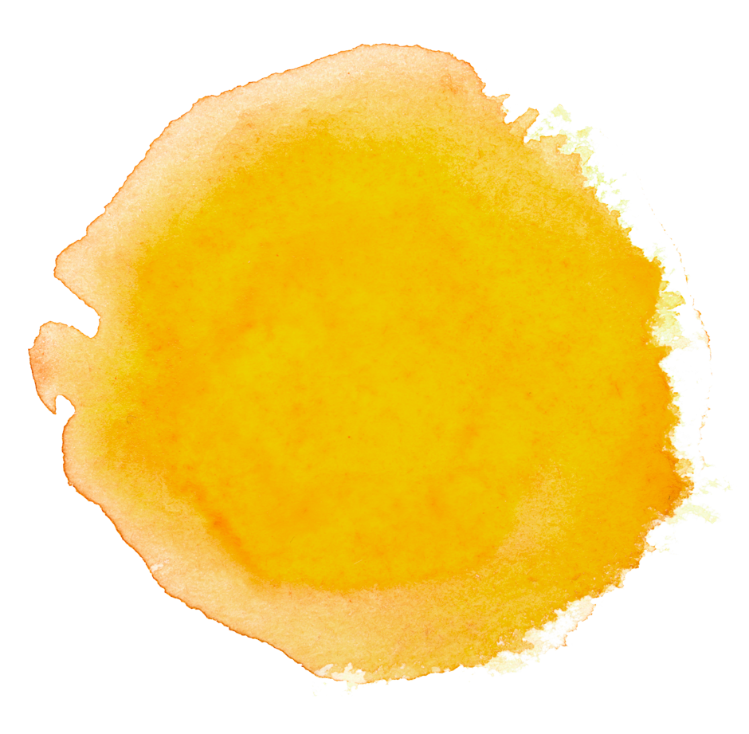
2 SuperCollider implementation
MIDI control & OSC messages

Slide 6



The FM Synthesis pattern:
Feedback Operator
Carrier Oscillator
Reverb
LPF

Slide 7
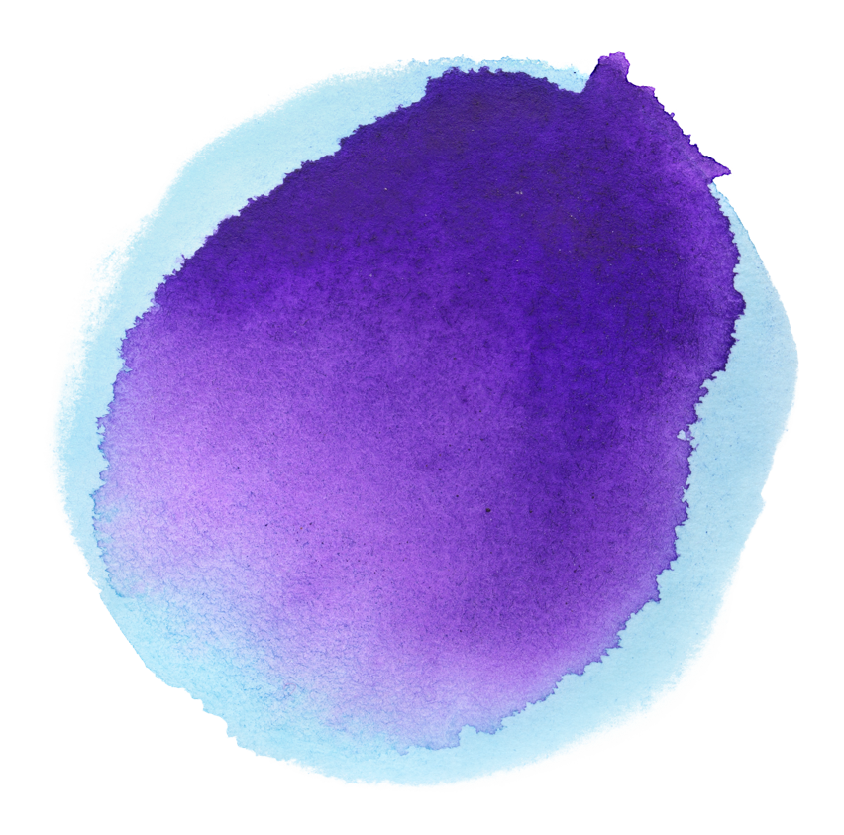
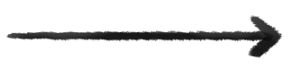


MIDI control
OSC messages
Monophonic Synth controlled by NoteOn and NoteOff functions
4 parameters:
X centroid
feedback
Y centroid
modulation amplitude
palm-index distance
LFO cut off
palm slope
reverb

Slide 8
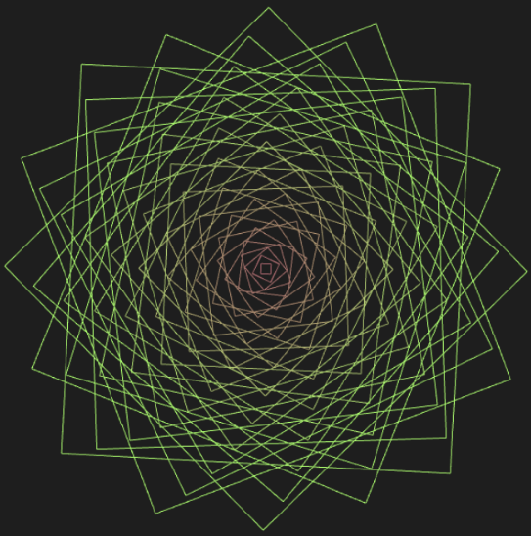
3 Interaction design
Using a pre-trained ML model from ml5.js and the p5.js framework for the animations implementation

Slide 9





Modules and libraries used

Slide 10
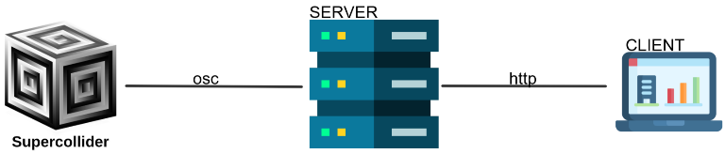
Application Architecture

Slide 11


Control Parameters
Centroid
Distace tip of the middle finger / palm base
Hand orientation

Slide 12
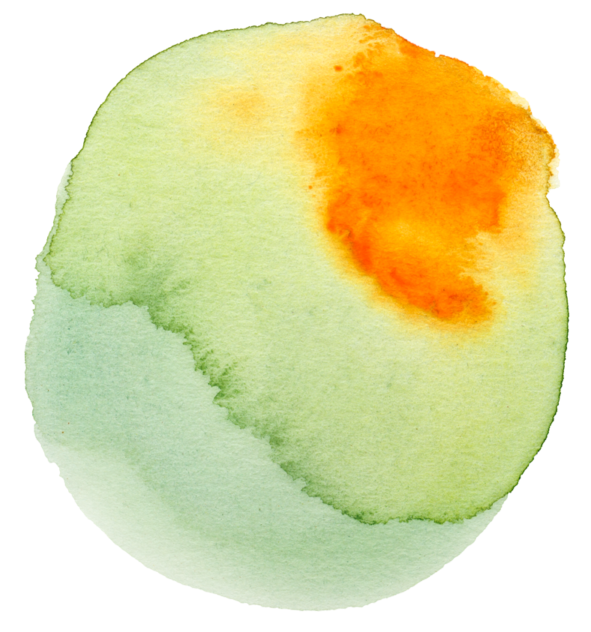
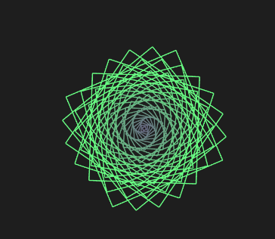
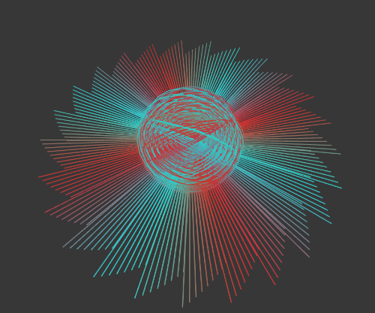

The three animations
Squared Rose
Sun Sphere
Double Square
It represents the variation of the reverb amount.
It represents the variation of feedback (sphere radius) and modulation amplitude (rays length).
Used for describing the variation of the LFO cut off.

Slide 13

4 Time for the DEMO

Slide 14

5 Improvements roadmap
More
Algorithms for
FM Synthesis
Polyphonic
Synth
More Synths

Slide 15
Funny facts
5000+ hours
130%
Everyone
Spent for parameters tuning
Better than our previous presentations
Will love this synthetizer

Slide 16
The End…
Thanks for your attention

